Slide 1
The Wish List
Duncan Morrissey
Zach Lister
Ed Ryan
Ben Mitchell
Yiannis Karavas

Slide 2
Introduction
Team Processes/Roles
Requirements
Design/Architecture
Implementation
Testing/Quality Metrics
Security
Demo!
Reflection/Conclusion
Questions

Slide 3
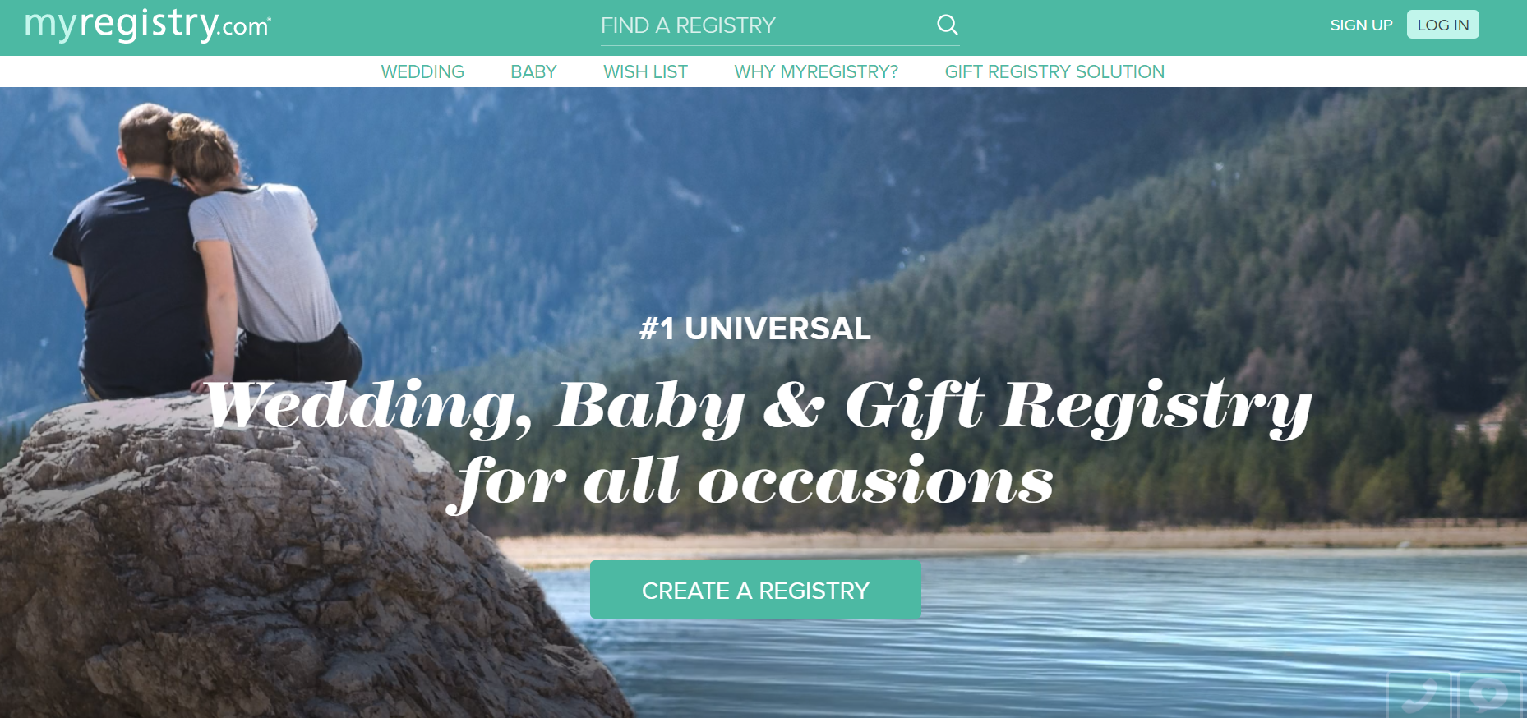
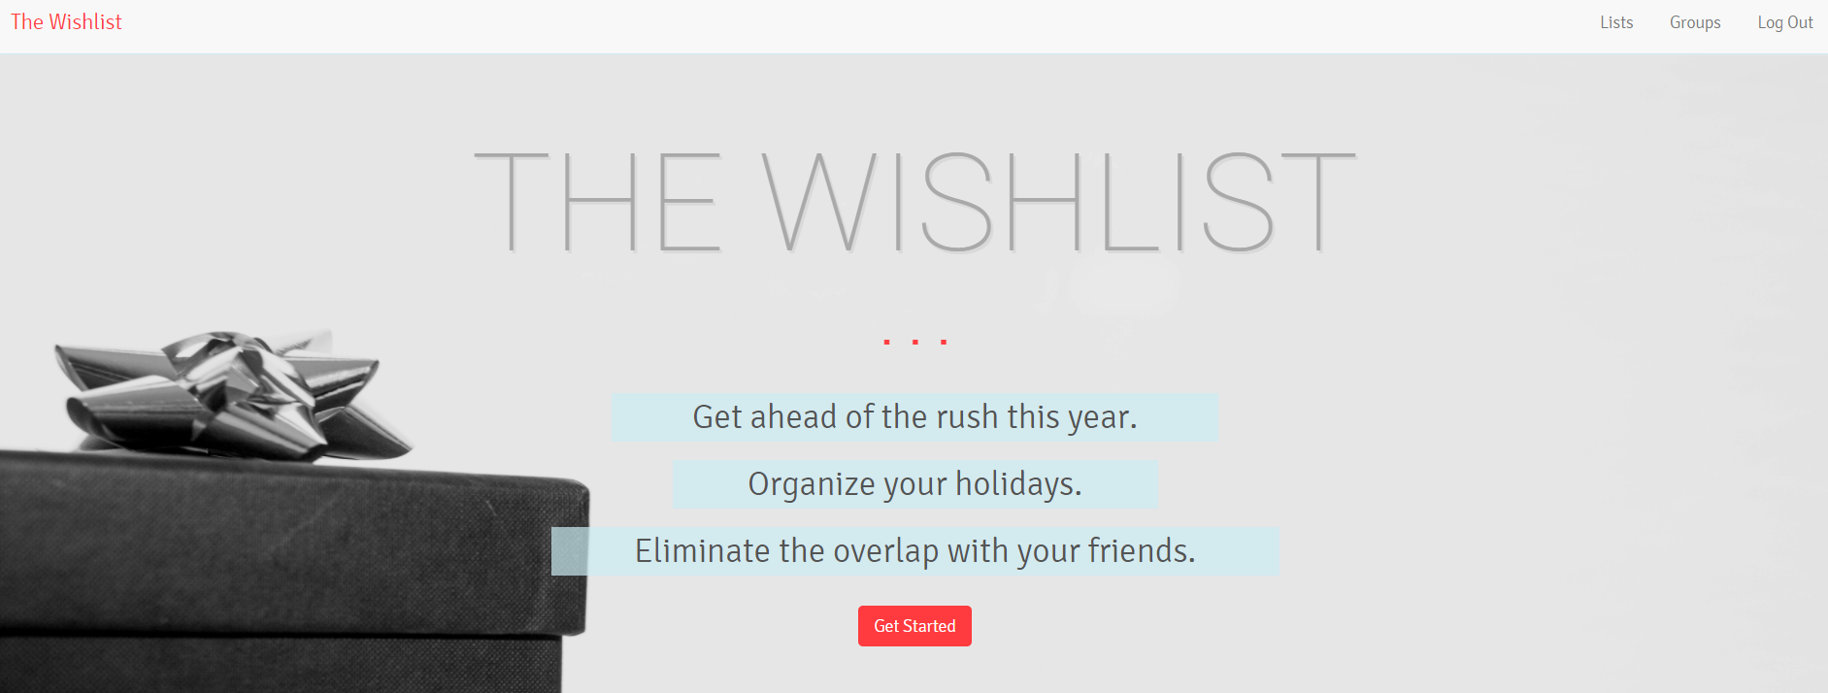
Our Project
Main value proposition: create an easily usable registry to eliminate overlap in gift exchange events
Differentiator

Slide 4


Process
Scrum lite
Github Pull Requests
Weekly Stand ups
Each iteration had deliverables
Slack for daily communication
List everyone’s overarching roles and what they contributed to the project

Slide 5
Roles
Duncan Morrissey - Project and Configuration Leader
Ed Ryan - Design and QA Leader
Ben Mitchell - Security Lead
Yiannis Karavas - Requirements and Implementation Lead
Zach Lister - Management Plan Lead

Slide 6
Requirements
This project started with 8 essential functional requirements all of which were successfully achieved:
Users create wish-lists: As a creator of a list, I want to be able to create a list.
Users modify wish-lists: As a creator of a list, I want to be able to modify a list after it has been created already.
Users delete wish-lists: As a creator of a list, I want to be able to delete a list.
Share wish-lists/control who accesses: As a creator of a list, I want to be able to share my list and control who sees it.
View someone else’s wish-list, navigate between wishlists shared with you: As a user of this app, I want to be able to view the lists that have been shared with me.
Seeing what items have been purchased on wish-lists shared with you: As a user of this app, I want to be able to view which items have already been purchased on lists that have been shared with me.
Mark as purchased items on others’ wish-lists: As a user of this app, I want to be able to mark an item as “purchased” on a list which has been shared with me if i have purchased that item.
Users see landing/homepage upon entering the site, with links to users/groups: As a user of this app, I would like to be greeted with a user friendly UI with comprehensible links to other user’s lists which have also been shared with me.

Slide 7
Requirements Cont’d
Non-functional and “nice to have” requirements completed:
Suggest users to add to a group: As a user, i would like to be able to suggest other users to the creator of a group whose wish-list may be pertinent to another user that the creator may have forgotten to add.
Allow users to add links and images of items for more clarity: As a user and creator of a list, I would like to be able to add a link to a website where an item can be purchased as well as an image link to allow viewers of the list to gain a better understanding of the item listed.
Fewer than 3 seconds to load a moderately sized list (10-100 items): As a user of this app, I would like my list to load quickly.
Scalability: Add a large amount of items to wishlist (up to 100 items): As a user of this app, I would like to be able to add a large amount of items to my wishlist.
Complexity: Fewer clicks to reach anywhere (maximum of 6 clicks): As a user of this app, I would like to be able to reach any page of this webapp from another within 6 clicks.

Slide 8
Design & Architecture
Model-View Controller (MVC) Architecture
Solution Framework

Slide 9

Model-View-Controller (MVC) Architecture
Default architecture for Ruby on Rails applications
Views present data to the user
Controllers processes user/application inputs
Models store data and interface with the database

Slide 10


Solution Framework
Ruby on Rails
Model
ActiveRecord
View
HTML5, CSS, Javascript and Ruby
Controller
ActiveController
Microsoft SQL Server
TinyTDS and activerecord-sqlserver-adapter

Slide 11
Security features
Rails 5 built-in security measures
CSRF prevention
XSS prevention
Brakeman gem to check Rails configuration for security problems
Authentication strategy
Used bcrypt gem to salt and hash username and passwords
Made authentication required by default by adding it to the base controller class
Created persistent sessions by storing session ID and encrypted user ID in browser cookies.

Slide 12

Production environment
We deployed to Amazon Web Services
We used Elastic Beanstalk service to create app environment
Storage (S3)
Compute instance(s) with AMI
Load balancer with auto scaling
Health monitoring
VPC
We used RDS to create a SQL Server Express instance in the same VPC
Complications
Lack of flexibility in deployment script
Tiny_TDS wouldn’t build on Amazon Linux

Slide 13
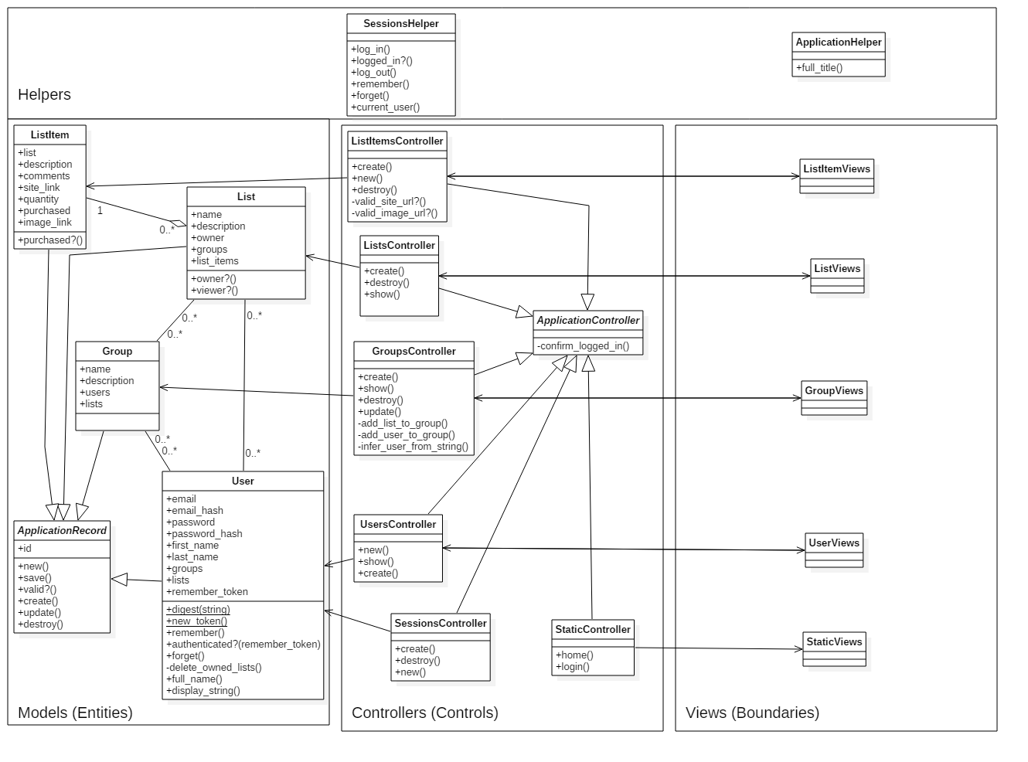
Class
Diagram

Slide 14
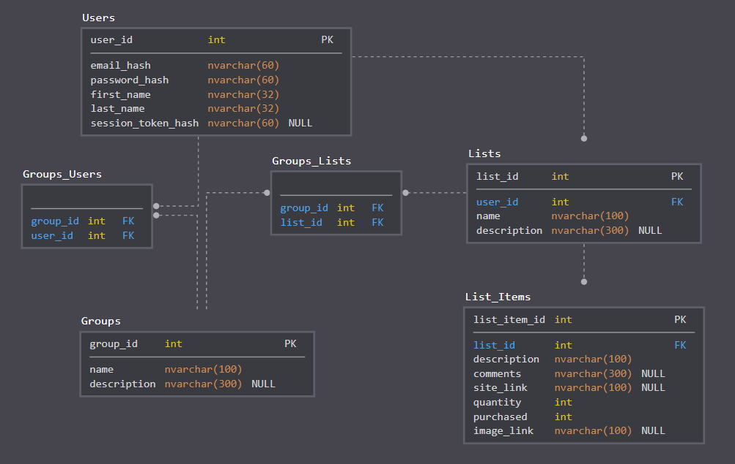
Database
Schema

Slide 15
Implementation
Project Structure
Code
Refactoring
AWS Deployment

Slide 16
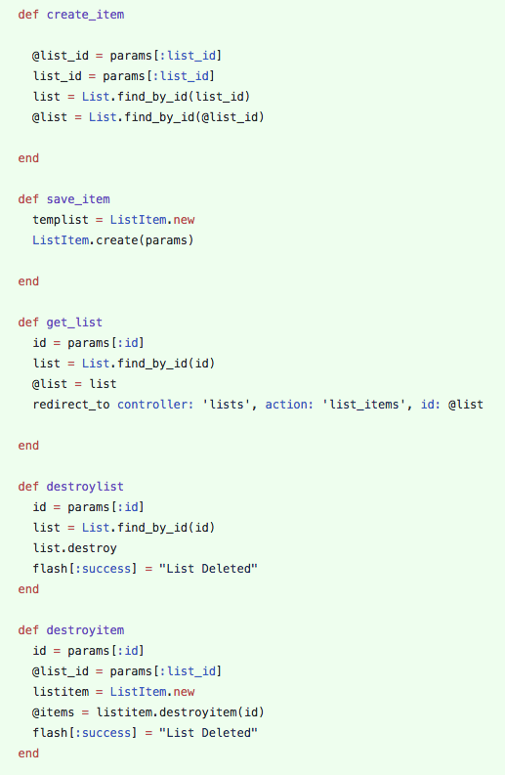
Refactoring
https://github.com/dmorrissey14/wishlist/blob/master/project/app/controllers/list_items_controller.rb

Slide 17
Testing
Unit testing with RSpec and SimpleCov
Whitebox Integration Testing
Functional System Testing
User Acceptance Testing
Final Test Results

Slide 18
Unit Testing with RSpec and SimpleCov
Started with MiniTest framework (default Ruby on Rails testing framework)
Moved to RSpec and SimpleCov following Iteration 1
Gives all the functionality of Minitest, but allows for wider range of test patterns
Adds code coverage
Pull request process updated to require unit test run prior to merging
Also allows for quick check for regression when performing code reviews
Code coverage results generated with every test run
Unit test failures usually addressed as code review comments

Slide 19
White-box Integration Testing
Work for the iteration spread across multiple branches
Following code freeze at the end of the iteration, branches merged to a “test branch”
Integration testing performed on this branch to ensure merges did not cause collateral damage
Testing was informal ad-hoc, with the focus depended on the changes made during the iteration
Issues identified during in integration testing handled differently depending on criticality
Issues critical to demo/new functionality are generally fixed prior to system testing
Issues for corner cases entered as bugs to be fixed in the next iteration

Slide 20
Functional System Testing
Repository of test cases to ensure end-to-end functionality
Given the project constraints, this was easier to implement than a fully-automated system test framework
System tests performed at the end of each iteration following a code freeze
System test failures addressed as bugs in PivotalTracker
Note: no system test failures were reported during the project
Notes:
Example (Iteration 3 results): https://drive.google.com/drive/folders/1943CmmZUqbEtvA6SdEfgo8zph5u-pmti

Slide 21
User Acceptance Testing
User acceptance tests written as a part of user stories / features
User acceptance tests completed as a part of closing out the user stories / features
Acceptance tests are black-box tests by convention
Issues identified in user acceptance tests mean the feature/story is not yet complete

Slide 22
Final Test Results
Test Type | Tests Passed | Tests Run | Test Pass Rate
Unit Tests | 56 | 56 | 100%
System Tests | 20 | 20 | 100%
Acceptance Tests | 16 | 16 | 100%
Final Code Coverage: 85.49%

Slide 23
Live Demo

Slide 24
Process Improvements
Mark user stories as finished in PivotalTracker
Improve pull request turnaround time

Slide 25
Questions?

Slide 26
References
Model-View-Controller Diagram
By RegisFrey [Public domain], from Wikimedia Commons
Ruby on Rails Logo
By User:ZyMOS [MIT (http://opensource.org/licenses/mit-license.php)], via Wikimedia Commons
Microsoft SQL Server Logo
https://greenwireit.com/it-tech-support-articles/microsoft-sql-server-express-windows-firewall-dynamically/

Slide 27
AWS Site
http://aws-deploy.azqpnpm6pm.us-west-2.elasticbeanstalk.com

